Slide 1
-
Cell4Cure – About us
Cell4Cure AB, a Swedish biotech company is pioneering immune tolerance therapies aimed at addressing significant clinical challenges such as anti-drug antibodies (ADAs), autoimmune diseases, and transplant rejection. The company’s proprietary platform leverages ex vivo-generated dendritic cells (DCs) engineered to induce antigen-specific immune tolerance. These tolerogenic DCs offer a targeted approach to mitigating unwanted immune responses while preserving essential immune functions.
Cell4Cure’s primary focus is on Anti-Drug Antibodies (ADAs), a critical issue in conditions like severe hemophilia A, where 30% of patients develop neutralizing antibodies against factor VIII (FVIII) treatments. With our lead product, ItolDC-028, we are ready to initiate a Phase 1/2a clinical trial in Europe to evaluate its safety and efficacy in hemophilia A patients with ADAs. This innovative therapy aims to restore responsiveness to FVIII, providing an alternative to conventional immune tolerance induction therapies.
Vision & mission
Offer curative or correcting personalized cell therapies mediating antigen-specific tolerance via our proprietary technology platform
Provide solutions for severe clinical challenges in complex medical conditions
Anti-Drug Antibodies (ADAs)
AutoImmune Diseases
Transplant Rejections
Provide an improved alternative to general immunosuppressing treatment to avoid their side effects, for example cancer and severe infections.
By achieving antigen-specific tolerance, our company aims to revolutionize the field and contribute to advancements in the treatment of these complex medical conditions. We aim to improve the life for several patients’ groups.

Slide 2
Development programs
In Cell4Cure, we develop curative or preventive personalized cell therapies mimicking the body’s own way of achieving antigen-specific tolerance. Our proprietary technology platform has reached key development milestones including EMA approval for a clinical trial and a robust GMP manufacturing process, based on $30 million in R&D investments.
As our first priority, we have selected to treat Anti-Drug Antibodies (ADAs) that is reducing or completely inhibiting the intended effect of life-saving biological treatments. These biological drugs may frequently be used in rheumatology and oncology, e.g. check-point inhibitors, TNF-α.
We have selected to treat Hemophilia A patients who have developed ADAs, so called “inhibitors”, against factor VIII in our first clinical program, “Recre8”. The rationale for selecting this patient group is based on availability of:
• GMP-manufactured antigen (i.e. recombinant FVIII)
• eligible patients (i.e. known to their treating physician)
• validated method available to measure Nabs
• large unmet medical need for these patients.
In parallel, we also plan to approach pharmaceutical companies with other biologicals where ADAs may develop and significantly reduce the clinical efficacy or introduce severe side effects. Examples of such biological include block-busters like Keytruda®, Yervoy®, Opdivo® and Humira®.
Additionally, Cell4Cure’s patented technology platform has the potential to extend its applications to autoimmune diseases and transplant immunology, positioning the company at the forefront of personalized medicine and immune tolerance research.

Slide 3
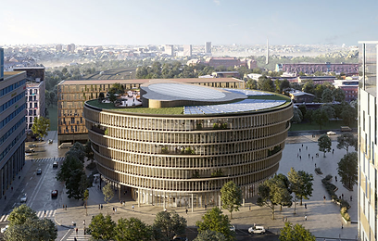
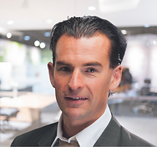
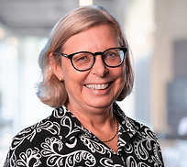
-
Invest in Cell4Cure
We are now seeking additional funding to advance the development of our pioneering technology platform in immune tolerance therapies. Invest in our:
Tolerance Inducing Platform addressing a multitude of clinical challenges Tackles the root cause of complex immune-mediated conditions with potential to improve patient outcomes and quality of life in several chronic diseases
World leading technology Therapies that induce immune tolerance using a unique platform technology based on tolerogenic dendritic cells
Potential IP protection until 2040 and beyond
Several out licensing and exit opportunities
Contact us
Visit us at The Park Forskaren
Hagaesplanaden 4
SE-113 68 Solna
Sweden
Business Development
Fredrik Gustavsson
Phone: +46 70-721 08 08 fredrik.gustavsson@cell4cure.com
Co-founder & CEO
Christina Herder
Phone: +46 70-374 71 56 christina.herder@cell4cure.com

